Slide 1


Traffic Sign Recognition using CNN

Slide 2
Introduction
Recently number of road vehicles has increased enormously due to technological achievements in motor Industry. Also it results in increase in accidents due to different causes, in which ignorance of traffic signs is considered as major cause in them.
There are several different types of traffic signs like speed limits, no entry, traffic signals, turn left or right, children crossing, no passing of heavy vehicles, etc. Traffic signs classification is the process of identifying which class a traffic sign belongs to.
Some key reasons highlighting the importance of traffic sign recognition: Enhanced Road Safety, Reduced Human Error, Traffic Management, Assistance to Autonomous Vehicles, Pedestrian Safety, etc.

Slide 3

Problem Statement
Traffic sign recognition is a vital component of modern road safety. However, there are several challenges and issues that need to be addressed in the development of a robust traffic sign recognition system.
In the world of Artificial Intelligence and advancement in technologies, many companies like Tesla, Uber, Mercedes, Toyota, Ford, Audi, etc are working on autonomous vehicles and self-driving cars. So, for achieving accuracy in this technology, the vehicles should be able to interpret and identify traffic signs and make decisions accordingly.

Slide 4
Objective
The objective of this project is to design, develop, and implement a highly accurate and efficient traffic sign recognition system using deep learning technique Convolutional Neural Networks (CNNs) to classify traffic signs in different categories and understand the signs that are important for autonomous vehicles,
To address the following key challenges and issues:-Diverse Sign Types, Varied Environmental Conditions, Real-time Processing, Human-Machine Interaction, etc.

Slide 5
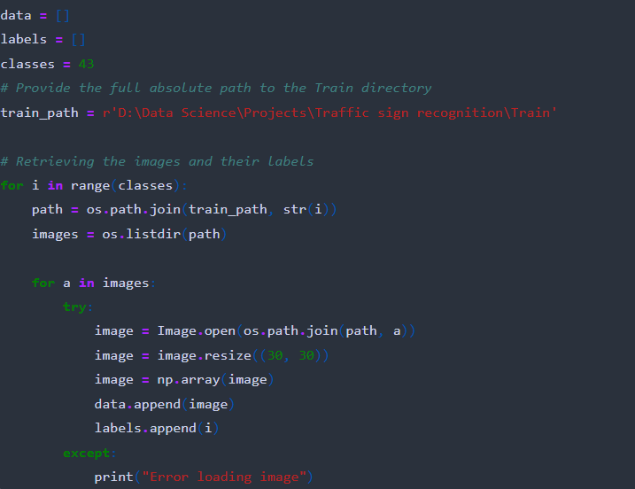
Data Loading and Preprocessing
The following dataset(GTSRB) from Kaggle contains more than 50,000 images of different traffic signs and is further classified into 43 different classes which is quite varying.
Data loading and preprocessing are crucial steps to ensure data quality and model compatibility.
Data Loading:
Utilized pandas to load and manipulate dataset.
Loaded images and labels from different traffic sign classes.
Data Preprocessing:
Resized images to a common dimension (30x30) for consistency.
Converted images to NumPy arrays for compatibility with neural networks.

Slide 6
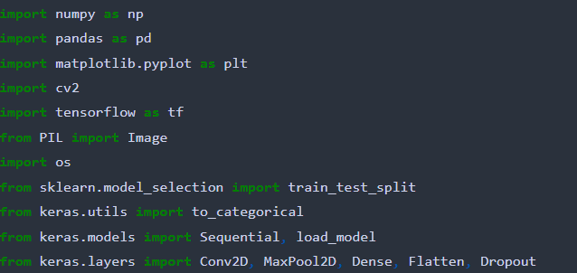
Libraries and Tools
These libraries and tools collectively enable data preprocessing, model building, training, and evaluation.
Libraries Used:
Numpy: Efficient numerical computations.
Pandas: Data manipulation and analysis.
Matplotlib: Data visualization and plotting.
cv2 (OpenCV): Image processing and computer vision tasks.
Tensorflow: Deep learning framework for building models.
Keras: High-level neural networks API for model construction.
Key Tools :
Google Collab Notebook: Development and testing of code.
Python: Core programming language for the project..
scikit-learn: Machine learning library for model evaluation and metrics.

Slide 7
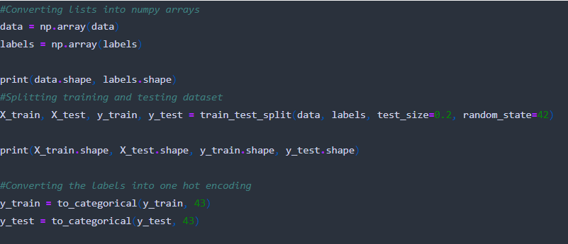
Data Splitting
Data splitting ensures a separate dataset for model training and evaluation, preventing overfitting
Train-Test Split:
Split the dataset into training and testing subsets.
Used sklearn's train_test_split function.
Common practice: 80% training, 20% testing.
Dataset Shapes:
Training data shape: (number of samples, width, height, channels)
Testing data shape: (number of samples, width, height, channels)

Slide 8
Model Architecture, Compilation, and Training
Model Architecture:
Sequential layers used for the CNN model.
Key layers: Conv2D, MaxPool2D, Dropout, Flatten, Dense.
Convolutional layers for feature extraction, pooling for down sampling, and dense layers for classification.
Model Compilation:
Compilation process involves specifying model components.
Loss function: categorical cross-entropy.
Optimizer: Adam optimizer for weight updates.
Metrics: Accuracy for evaluation.
Model Training:
Training using the ‘fit’ function.
Number of epoch : 15.
Batch Size:64.
Validation data used to monitor performance.

Slide 9
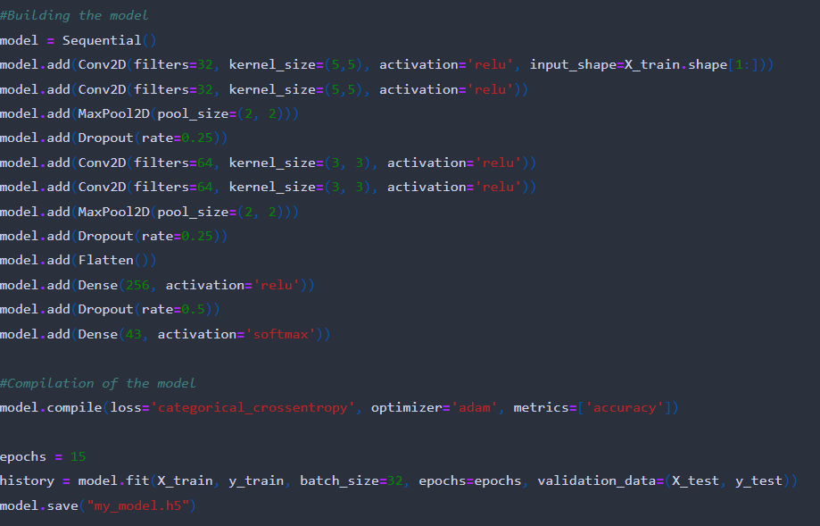
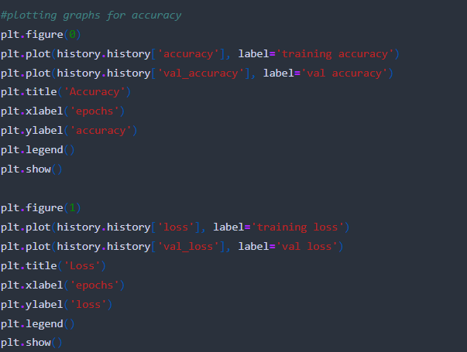
Model Building
Training and validation accuracy

Slide 10
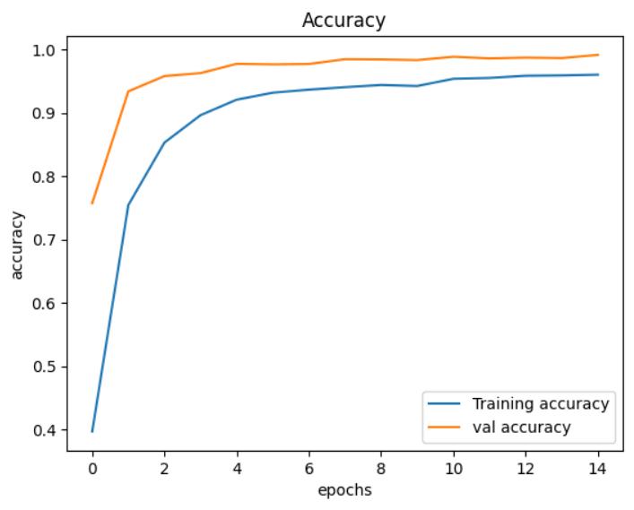
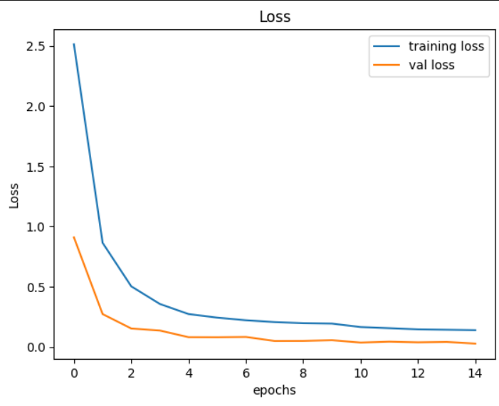
Visualization
Accuracy vs Epochs
Loss vs Epochs

Slide 11
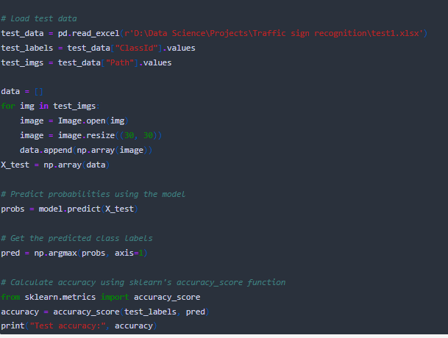
Model prediction
Model evaluation ensures understanding of real-world performance and accuracy.
Predictions and Accuracy:
Predicted class probabilities using the trained model.
Calculated accuracy using sklearn’s ’accuracy _score’ function.
Test Accuracy:
Displayed test accuracy achieved by the model by using test data and got an accuracy of 95%.

Slide 12
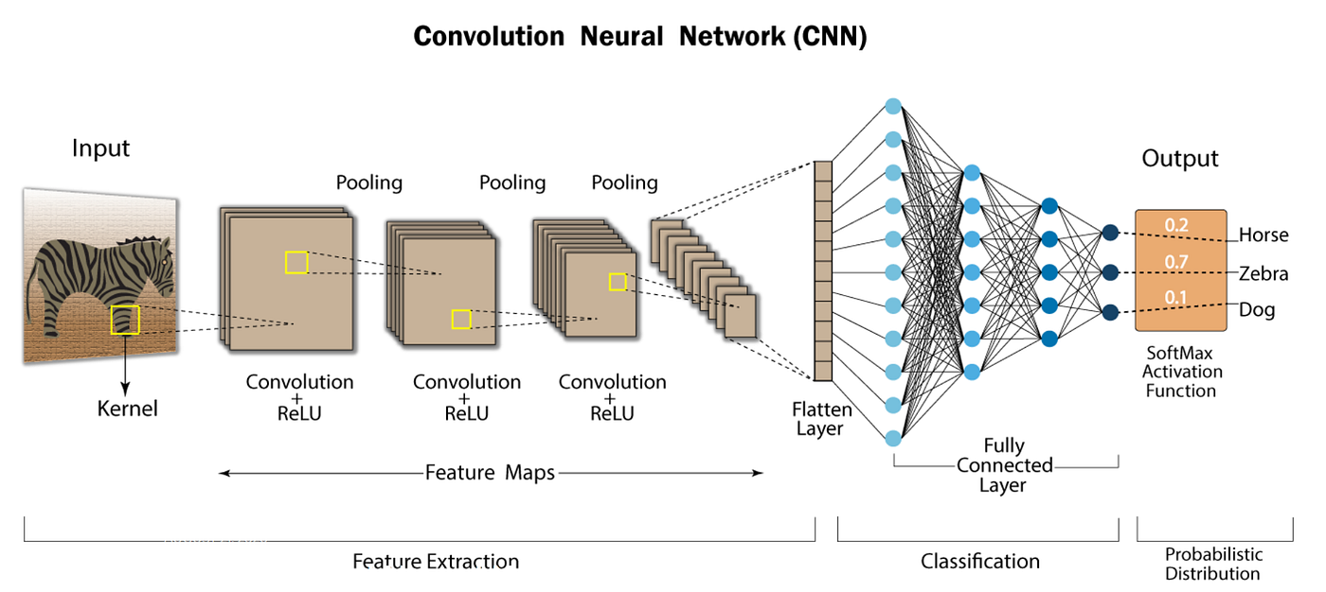
CNN model architecture

Slide 13
Conclusion
Project Accomplishments:
Successfully built a CNN model with an accuracy of 95%.
Correctly predicted the testing image for data.
Key Learnings:
Understanding of CNN architecture and its applications.
Practical experience in data preprocessing, model training, and deployment.
Future Possibilities:
Enhancements in model accuracy through data augmentation and fine-tuning.
Integration with real-time traffic monitoring systems.
The project showcases the potential of deep learning in real-world applications.
Thank you!

